Slide 1

Skills/Courses Recommender System
Internship Presentation
13 May

Slide 2

Content
Introduction
Considerations & Approach taken
Data Extraction, Transformation & Exploration
Modelling & Evaluation
Demo
Next Steps
Internship Learning Points
Notes:
I will introduce the project briefly and run through the considerations for the approach, before jumping into the stages of building the recommender system. Then I will do a short demo and end off with future steps and my own internship learning points

Slide 3





Project Objectives
Business objectives:
To empower employees to take charge of their learning and development by identifying their skills and training needs; and to roll out a course recommendation system for employees’ self-service.
Technical objectives:
Identify the skill gaps by taking in employee’s current skill sets and proficiency levels and to compare with their current job description. i.e. The set of skills he/she needs to perform their job that they do not currently possess.
Skill gap
Ideal skillset for the job
Active user’s skillset
Build a course recommendation system that matches employee skill gaps to to relevant courses in the database. To recommend these courses to employees.
Success criteria is to attain Proof of Concept(POC).
Notes:
For this project, the business objective was to empower employees to take charge of their learning and development, by identifying their skills and training needs. and to build a recommender system that could help them do so on their own.​
​
The technical objectives of the project would be 2 part. The first part of the system should identify employees’ skill gaps vis-à-vis their current job title..​
The second should take these skill gaps and match them to relevant courses in a course database. Essentially recommending courses to employees that will help them address their own skill gaps.
The Success criteria was to get POC of such a system

Slide 4

Requirements
POC should be based on established Competency Frameworks, however there are no official frameworks in the organization yet.
Course recommendations should be anchored on employees’ skill gaps vis-à-vis their own job role
Should be able to explain the rationale behind the recommendations made (not black box)
Notes:
Based on our org requirements, these areas were taken into consideration while building the system.
1- Firstly, the recommender system to be based on established competency frameworks. At present, the org does not have our own internal frameworks yet.
2- In the same vein, because the course recommendations should be driven by the competency frameworks, the recommendations should be based solely on the skills required by the employee to perform his/her current job (as compared to-for example- basing it on how enjoyable an employee found a particular course or based on the courses taken by others)
3- Lastly, it was important that the rationale behind the recommendations could be explained to bosses and employees. Rather than it being black box

Slide 5

Considerations & Approach taken

Slide 6



Comparing Recommender types
Content-based
Recommend courses based on how similar a course is to past courses the employee has attended
Collaborative-filtering
Recommend courses to employees based on courses attended by similar others (‘neighbors’).
Knowledge-based
Recommend courses based on explicit specification of the kind of skills the employee wants.
Notes:
3 main approaches for most recommender systems are Collaborative-filtering, Content-based and Knowledge-based. In this context they can be described as:

Slide 7
Approach | Pros | Cons
Content- based: | Does not need data from other users (only active user). Can recommend courses not yet rated by any user. No cold-start problem | May not be useful if recommendations are based on user’s past attended courses as: Recommendations are limited to users existing skillset and would miss out on skills that the user may require for the job but does not already posses. User does not need to attend another course covering the similar content.
Collaborative-filtering: | No domain knowledge needed because the embeddings are automatically learned. Serendipity (i.e., novel items introduced to user). | Difficulty identifying ‘similar others’ as employees in the same department may require different skills and have different skill gaps. Cold-start problem exists.
Knowledge- based: | No cold-start problem. | Needs domain knowledge- Users may not be aware of their own skill gaps.
Note: cold start occurs when a novel item has insufficient user data for an accurate recommendation to be made.
Notes:
I will briefly run through the pros and cons of each, within the context of the org
For content based, while it only required information from an individual employee to run the model, this approach would not have been useful if we had gone the typical route of recommending courses similar to what an employee had attended in the past.
For collaborative filtering, in contrast would allow novel items to be recommended to the employee rather than having more similar courses. The limitation to this approach was how to identify these groups of ”similar employees” and overcoming the coold-start problem. Cold-start Occurs when a novel item has insufficient user data for an accurate recommendation to be made.
Lastly knowledge based, though straightforward, may need employee to have more domain knowledge

Slide 8
Considerations for eventual approach
Content-based approach was chosen over collaborative filtering (CF)
Recommendations should be anchored on employees’ skill gap with course (user preference/rating not a priority)
CF would require enough employees to attend a course recommended it (e.g. newer courses would not get recommended)
Not everyone in a department (similar others) uses the same skills nor have the same skill gaps (CF would recommend the same courses to them)
Limited historical data on employee competency available
Use of established Competency Framework ICT sector
This version of the system should allow employees to input their own skill level
Notes:
Before we jump into the actual model, I will run through some of the thought process and challenges along the way, that led up to the final model that was built. Some of these tie in with the considerations that I mentioned earlier
1- firstly, a content based approach was chosen over others. This ties in with wanting the competency frameworks to drive the recommendations rather than other factors.
The eventual model was a hybrid between the content- and knowledge-based approach. Instead of the typical content-based approach (e.g. courses recommended based on employees’ past attended courses), the system used the ‘content’ of an employee’s skill gaps to recommend courses. The courses with the most similar content to an employee’s skill gaps would thus be recommended. Coupled with this, a knowledge-based approach was also incorporated by getting the user to input some job related fields (e.g. current job scope, current proficiency).
While Collaborative filtering was also considered (by taking user’s colleagues from the same department to be the ‘similar others’), it was concluded that not everyone in the same department would use the same skills nor have the same skill gaps.
2- second,
The org has yet to roll out tech competency framework and does not quantitatively track employee ICT competencies at present
thus, this version of the system allowed employees to input their own skill level.
For instance, this could be done after SAR convos where the employee goes through the competencies with their supervisors
( employee’s supervisors conduct staff reviews to go through performance indicators with employees. Based on these discussions, employees would roughly know at what level they are proficient for each competency and would be able to indicate in the system.)

Slide 9
Considerations for eventual approach
Initially built a generic recommender
Useful in recommending introduction courses to employees who would like a change in job scope / new to the job
Challenge was that it does not recommend courses for each individual competency for the job
Instead, proficiency descriptions that corresponded to each employee skill gap was used
Compared recommending level-by-level (Level 1, Level 2, Level 3) vs. combining proficiency levels (Levels 1+2+3)
Alternatively, Levels 1+2→Level 3
User input target job
1 list of recommend courses that cover the full set of competencies for the job
Extract full set of competencies required for job
TFIDF all competencies + course features
Similarity between full set of competencies and course content
Notes:
Next,
I initially started of with a generic model, where the full set of competencies required for the job, was taken in totality. Which mean the similarities would be between the full job scope instead of each individual competency. The challenge was that this approach could not recommend a list of courses to address each skill gap. the generic model could be more useful for employee in a new job role and wanted to be recommended all encompassing or introductory courses.
Lastly, I considered whether recommendations should address skill gaps at each level, or whether the gaps could be grouped together if the skill gap was too big. For instance if I need programming level 4 and I am only at programming level 0, should the recommender recommend me courses for programming level 1,2, 3 separately or simply 1 list covering all proficiency levels?
Alternatively, the recommender could return one list of recommendations to cover lower levels 1 and 2 and another to cover higher level 3..
For simplicity of the proof-of-concept, the current version incorporated a level-by-level recommendation (i.e. an employee with the skill gap described above would be pushed 3 recommendation lists, one for each proficiency level). Alternative groupings could still be easily incorporated in future versions of the system

Slide 10


Recommender system components
Employee (Active user)
Reco System
Notes:
I will now outline the components of the recommender system that was built. Here you can see both the user flow as well as the recommender system flow. Those in blue will be actions taken by the user.

Slide 11

Recommender system components
Part 1: Flag out employee skill gaps
Part 2: Recommend courses to address skill gaps
Employee (Active user)
Input Target job (select from list)
Input own current proficiency level vis-à-vis skill required for target job
Skill gaps pushed back to employee
Reco System
Extract full set of Competencies required for target job scope (and respective proficiency levels)
Compare employee’s current proficiency with ‘ideal’ to identify skills gaps
Profile of skill gaps that user needs to address
Notes:
2. There are 2 parts to the system. The first part is to flag out employee skill gaps vis-a-vis their current job role. The second part of the system was to recommend courses that can plug said skill gaps.
3. Lets start with part 1 (click). Here, the employee first selects their job title from a dropdown list of jobs taken from the competency frameworks(should be finite). The system returns the list of competencies for their indicated job and the employee will proceed to indicate their own level of proficiency.
The system then calculates the ‘gap’ between the expected skills for the job and the employee’s actual level of skill.
(click) These skill gaps would be pushed back to employees for their own awareness.
The skill gaps identified would also be used as input for the next part of the system.(click)

Slide 12

Recommender system components
Part 1: Flag out employee skill gaps
Part 2: Recommend courses to address skill gaps
Employee (Active user)
Input Target job (select from list)
Input own current proficiency level vis-à-vis skill required for target job
Recommended courses pushed to employee
Skill gaps pushed back to employee
Reco System
Profile Analyzer:
Feature extraction of proficiency descriptions that correspond to each skill gap
Recommender:
Calculate similarity based on descriptions, i.e. Match courses that cover the respective competencies, at the correct proficiency level
Extract full set of Competencies required for target job scope (and respective proficiency levels)
Compare employee’s current proficiency with ‘ideal’ to identify skills gaps
Profile of skill gaps that user needs to address
List of course recommendations for each skill gap
Content Analyzer:
Feature extraction of content coverage for all courses in course database
Notes:
In this part, the system will extract the features of both the proficiency descriptions that correspond to the users skill gaps (which as earlier explained, refers to the observable indicators of an employee’s skills)
The system will also extract the features of the course content coverage
After extracting and combining feature data from the proficiency and course descriptions, TF-IDF matrix is created, which counts and weights words in all descriptions, and a (cosine) similarity score between the sparse text-vectors is calculated.
Those with the highest similarity will be pushed back to the user
So for each skill gap identified, a list of recommendations will be returned to the user.

Slide 13






Technologies used
Data Extraction/ Transformation
Data visualization
Modelling
Front end
Apache Tika
NLTK (Natural Language Toolkit)
wordcloud
Altair
Notes:
For this project, the following technology was employed.
Code was all done in python language on jupyter notebook. Apache tika library was used to extract data from PDF files
and scikit learn and the natural language toolkit library were used mostly in building the model
Tableau and word loud library was then used for the visualizations in the exploration phase and
For front end, streamlit was used. For this the code was done in spyder and altair library was used for the graphs on the user interface

Slide 14

Data Extraction, Transformation & Exploration
Notes:
Moving on the building the system, starting with the data and exploration

Slide 15


Data acquisition
User
Courses
Notes:
Employee(user) and courses data was required as inputs for the model

Slide 16
Data acquisition: User data
User
Sources:
Open-source SkillsFuture ICT competency frameworks
Complement with employee’s (active user’s) input
Required:
Current job title of employee
Ideal set of skills required by employee to carry out their job
Current proficiency of user via-a-vis each skill
Notes:
For employee data
Current job title of the user is required, along with the ideal skills or competencies required to carry out that job. We also need to know the users current level of competency/proficiency
Firstly for competency and proficiency data- open source competency framework was used
As the org has yet to roll out their own competency frameworks, the publicly available SkillsFuture ICT competency frameworks was used for the current POC. This was because the data was highly relevant and in a similar structure to what the the org wants to develop their own framework on.
As we also do not officially track technical proficiency of employees, the workaround was to allow employees to indicate their own current proficiency level. Thus our eventual system will cater for employee’s input, which will be covered later.

Slide 17
Data acquisition: Course data
Courses
Source:
Open-source Coursera database with course details and content descriptions
Required:
Course title
Skills covered for each course
Notes:
Second For course data, we need the course title and the skills covered for each course
To obtain this, open-source Coursera database was used and the content covered was pulled from the course descriptions provided.

Slide 18
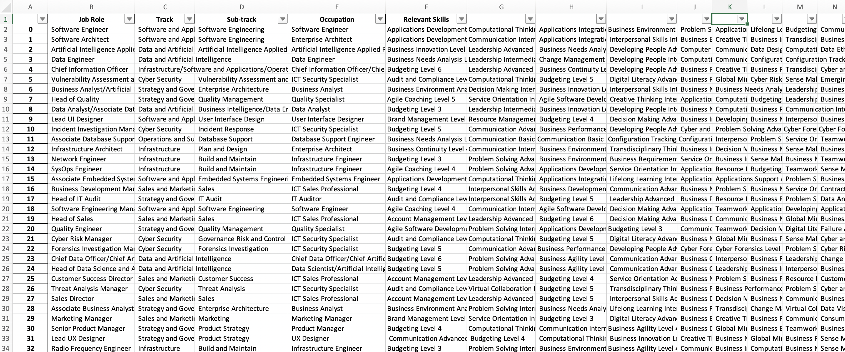
Extracting Competency framework data
Apache Tika library used for PDF content detection and extraction
Extract competencies required for job (including the respective proficiency levels of each competency (e.g. Level 1-6 for technical skills)
‘Track’, ‘Sub-track’, ‘Occupation’ and ‘Job Role’ data fields extracted
Saved into data frame
Skills>>
SkillsFuture competency framework
(PDF)
Use: To identify employee’s skill gaps
Notes:
For the extraction of competency data,
From the SkillsFuture documents, I extracted the competencies required for each job and the required level of proficiency(e.g. applications development level 1)
Later on this would be used to identify the active employee’s skill gaps vis-à-vis their current job.
Other job related fields were also extracted for exploration.
These steps were iterated over all the PDF files and then saved into a data frame

Slide 19
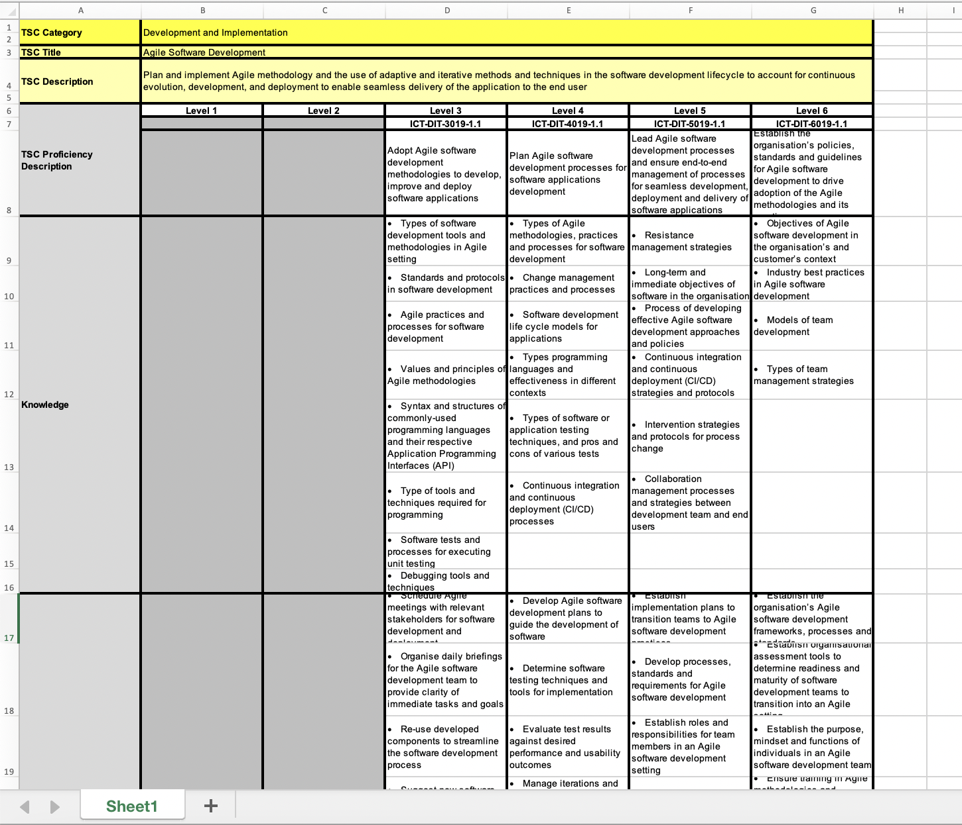

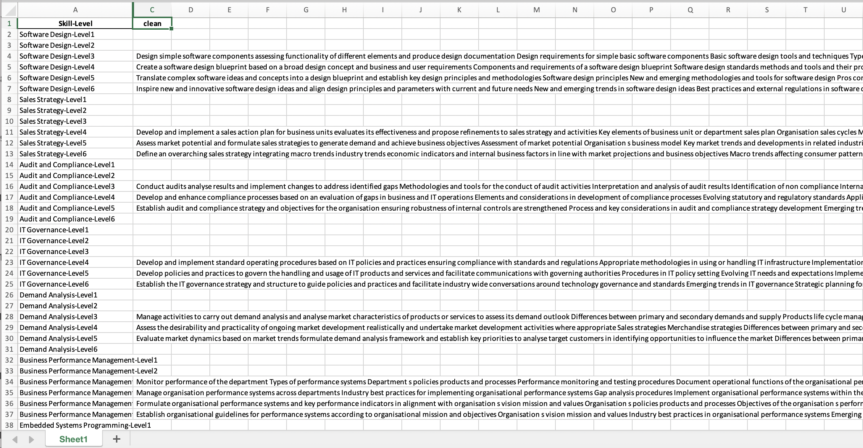
Extracting Proficiency data
Extract description of each level of proficiency that is tagged to a competency (e.g. what indicators would an employee at Level 1 proficiency of ‘Agile Software Development’ show)
Clean up text data (e.g. remove punctuation, handle NAs)
Saved into data frame (1 proficiency level description per row)
Proficiency description for each competency
(Excel)
Use: Recommender model
Notes:
Then I extracted the corresponding proficiency descriptions for the levels of competency, So for each competency (represented by the excel image on the left), we should see a description of the performance indicators that an employee with say level 1 proficiency should posses, vs level 2, level 3 and so on. As you can also see, not all levels have description, so we had to deal with Nas.
These were all found in separate excel sheets, so again, the steps were iterated over the Excel files and saved into a data frame → these Proficiency descriptions will be later used as a direct input into the recommender model

Slide 20
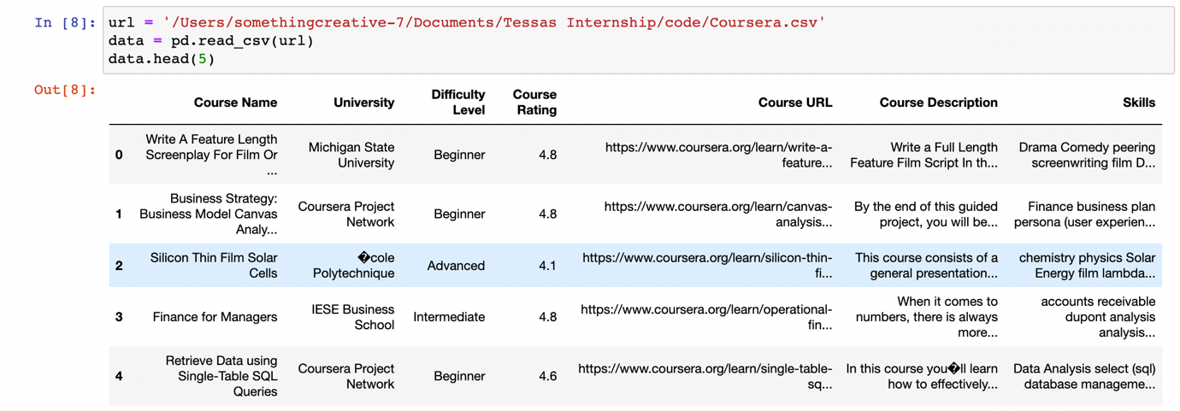
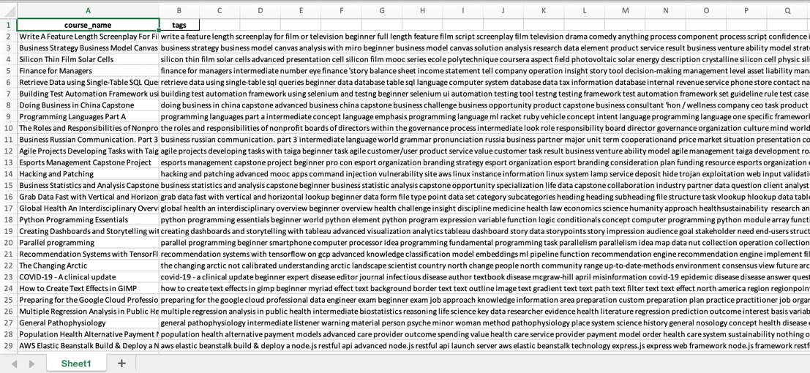
Extracting Course content data
Extract course details (‘Course Name’, ‘Description’ and ‘Skills’ data fields)
Clean up text data (e.g. remove non-words)
Saved into data frame
Coursera data
(Kaggle dataset; CSV)
Use: Recommender model
Notes:
Lastly, i extracted course details and description of what content each course will cover.
Text data was pre-processed, and non-words were removed.
Upon further inspection, it was also discovered that the difficulty level (click-red arrow) was tagged rather subjectively and was not standardized, thus this data was not used to refine the model later on.
The course content textual data was also used as a direct input in the model

Slide 21
Extracted proficiency data
Extracted competency framework data
Extracted course data
Notes:
These are where the extracted data was later fed into.
As mentioned, competency framework data was used in part 1 to identify employee skill gaps, while the proficiency data and course data was used to build the model itself

Slide 22
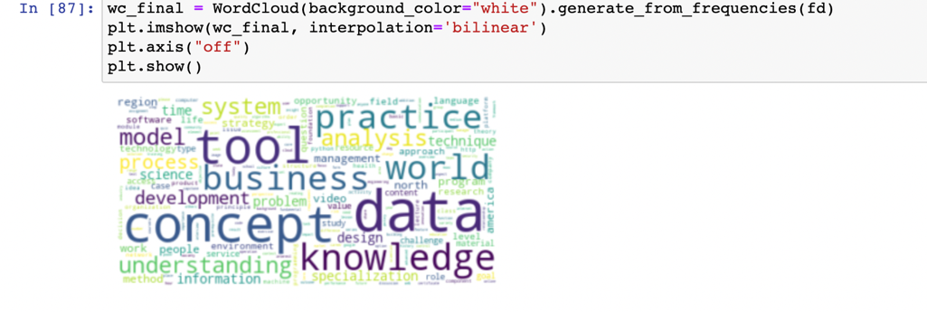
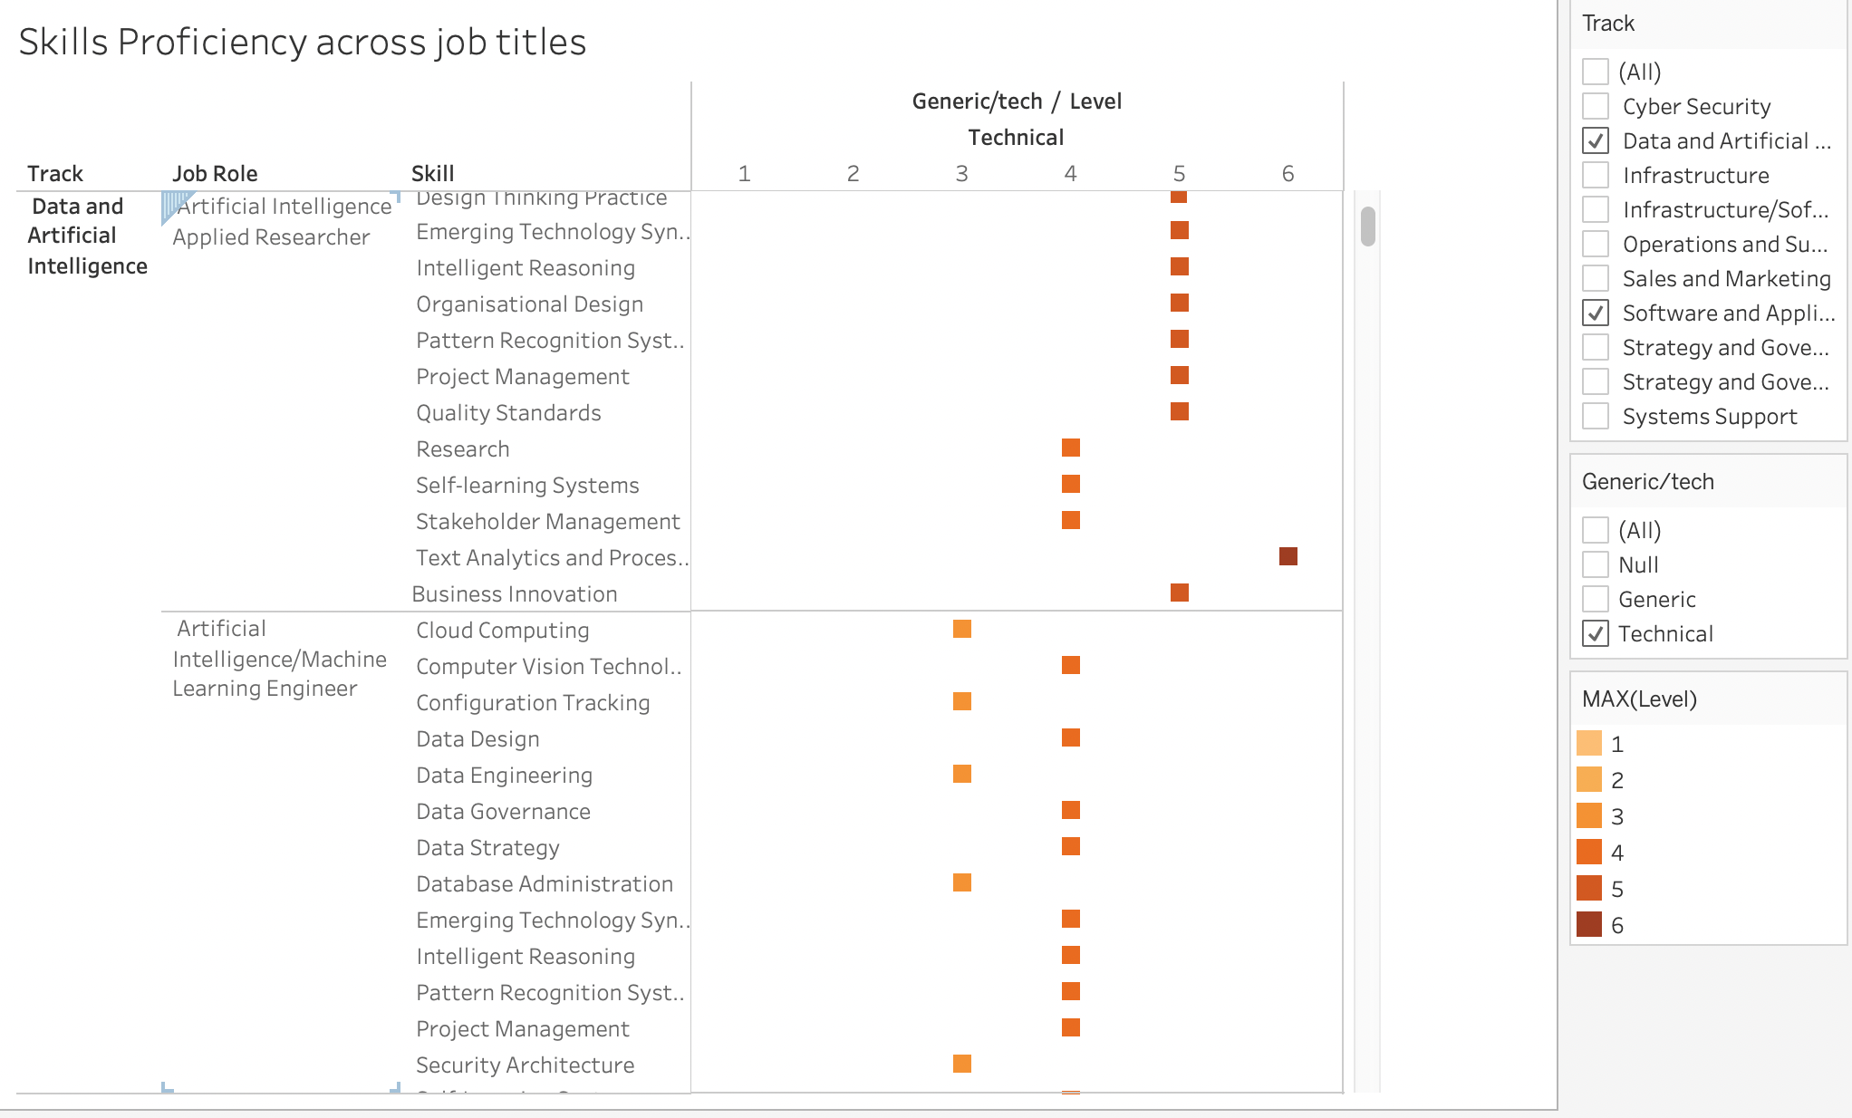
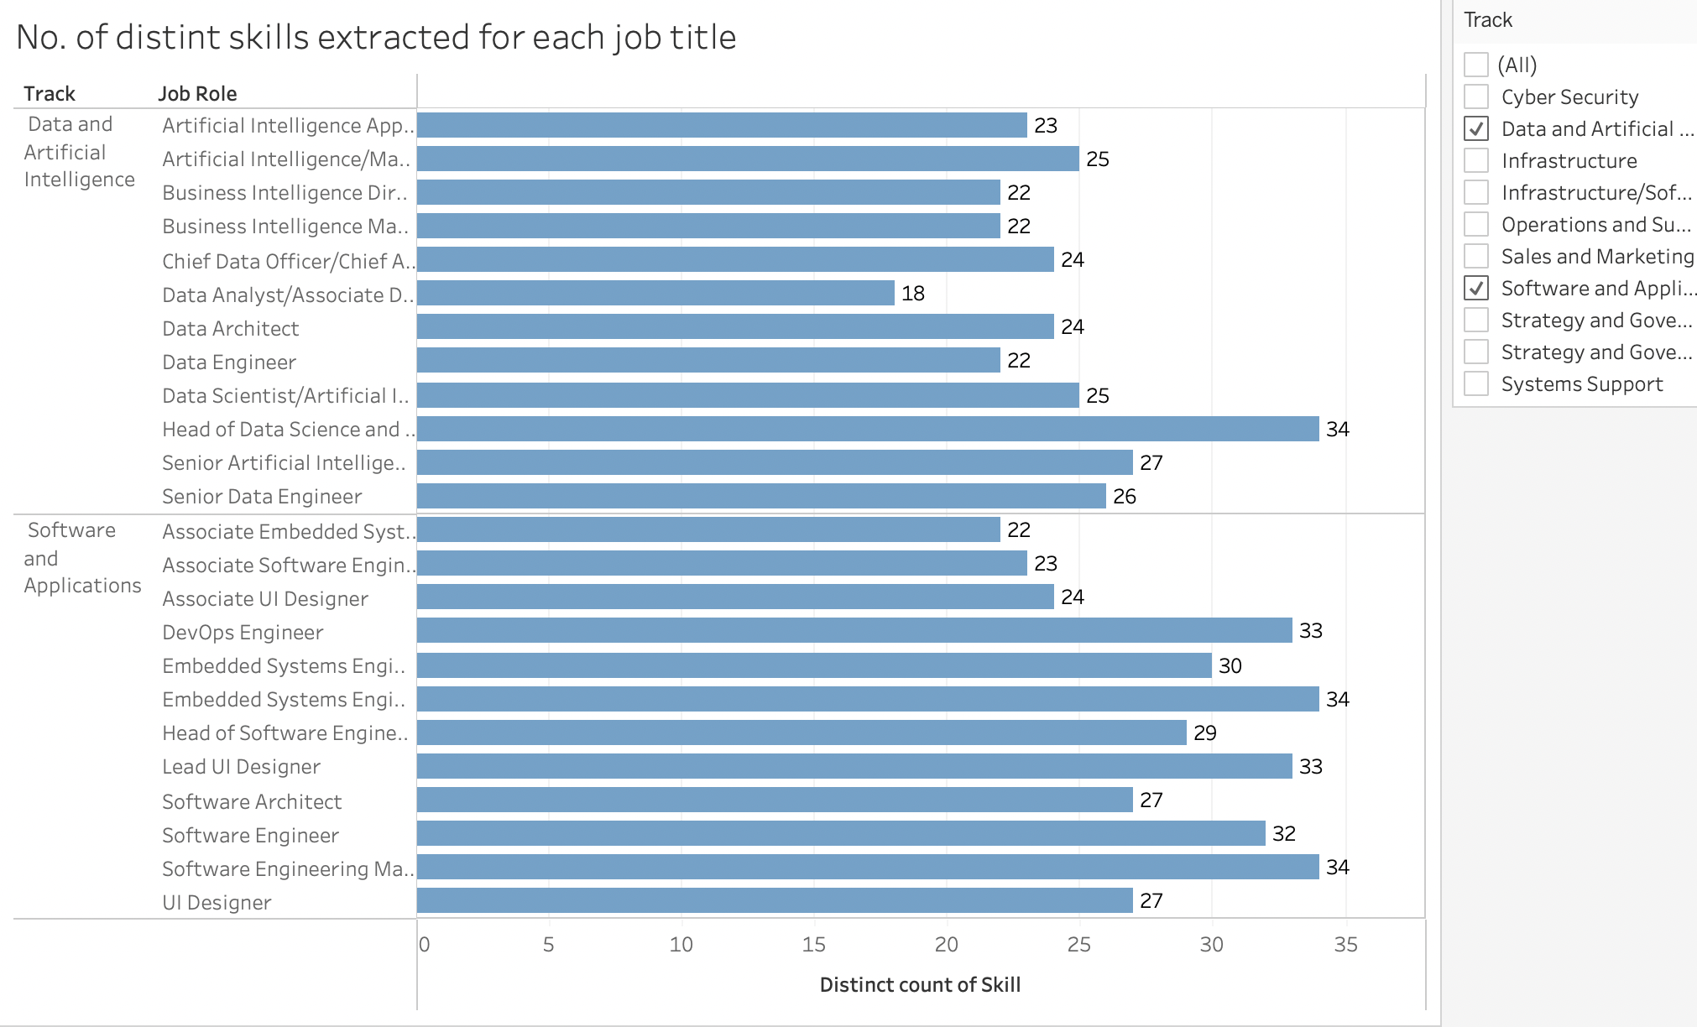
Exploratory Data Analysis
Generated Wordcloud from course description
Wordcloud shows that most of the MOOC on Coursera are targeted at tech skills
Built Dashboards for a visual representation of the competencies tagged to each job title
On average:
‘Data and AI’ type jobs have 24 core competencies while
‘Software and Applications’ jobs have 29
Notes:
After extracting the data, some basic descriptive analysis was done to get some sensing of the data. (click) For example, based on term frequency, many of the Coursera online courses seem to touch on ICT skills, which are relevant to the CSIT.
From the SkillsFuture competency frameworks, a visual representation of the corresponding level of proficiency required for each competency, per job was done. The number of competencies required for each job role was also summarized. (click) For instance, data and AI jobs have 24 core competencies while Software and applications jobs have 29
Potential uses..

Slide 23

Modelling & Evaluation
Notes:
Now on to modelling

Slide 24
Content analysis: Text pre-processing
Removing punctuation
Tokenizing
Lemmatization
Removing Stopwords
Conversion to lower case
Stemming
Count vectorization
Note: will explain each of these steps verbally
Notes:
For feature extraction,
Both proficiency and course description was processed with the following steps to get TF-IDF for the model.
This included tokenizing(which means to break text into individual linguistic units)
removing stopwords (which are contextually meaningless words that we want the model to ignore) and converting text to all lowercase
Stemming and Lemmatization→ which essentially means to reduce all forms of a word into their common base form (e.g. studying/studies is studi)
Count vectorization was done to represent these text as numerical feature vectors- allowing us to quantify them
X
Removing stopwords - these are unhelpful words like 'the', 'is', 'at'. These are not helpful because the frequency of such stopwords is high in the corpus, but they don't help in differentiating the target classes. The removal of Stopwords also reduces the data size.
Conversion to lower case - words like 'Clinical' and 'clinical' need to be considered as one word. Hence, these are converted to lowercase.
Stemming - the goal of stemming is to reduce the number of inflectional forms of words appearing in the text. This causes words such as “argue”, "argued", "arguing", "argues" to be reduced to their common stem “argu”. This helps in decreasing the size of the vocabulary space. There are many ways to perform Stemming, the popular one being the “Porter Stemmer” method by Martin Porter.

Slide 25

Content analysis: TF-IDF
To help the model focus on more meaningful words from the course and proficiency descriptions, Term Frequency-Inverse Document Frequency was used.
Determines the relative importance of words and discounts words that are too frequent (i.e. noise)
E.g. prepositions (e.g. for, in, the) or words like ‘learn’, ‘course’ will occur frequently across all documents; but cannot help us to distinguish between each course description.
Based on TF-IDF, similarity scores are calculated. The recommender ranks and returns the Top 10 most similar courses
Similarity score
Description of skill gap
Description of course content
Notes:
For the model, we used term frequency inverse document frequency or TF-IDF. Instead of simply using word frequency, this approach weighs words by how rare they are in our dataset, discounting words that are too frequent and just add to the noise.
E.g. prepositions or words like ‘learn’, ‘course’ will occur frequently across all documents. By taking a bag-of-words approach, those terms will have a very high score (counts number of occurrences). However, the terms that occur in every document are not important to distinguish the documents.
however these terms will not help us to distinguish between the content of the courses

Slide 26
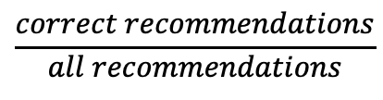
Evaluation
Purpose of slide: to explain how model was evaluated
For model evaluation, Precision (”hit rate”) was calculated. As there were no ‘ground truth’ labels in the data, Skills tagging found on Coursera was used as a proxy in the precision calculations
Sample of evaluation:
Match?
Proficiency gap A | Recommendation 1: Course W | Skills tagging from Coursera for course W | Yes
Competency gap A Competency gap A | Recommendation 2: Course X | Skills tagging from Coursera for course X | Yes
Competency gap A | Recommendation 3: Course Y | Skills tagging from Coursera for course Y | No
 | .... | … | …
 | Recommendation 10: Course Z | Skills tagging from Coursera for course Z | Yes
$$\frac{correct recommendations}{all recommendations}$$
Precision was found to be 0.63
26
Notes:
For model evaluation Precision (”hit rate”) was calculated across the above variations. As there were no ‘ground truth’ labels in the data, Skills tagging found on Coursera was used as a proxy in the precision calculations.
So what I did was to run the model on some test cases. Here you can see an example where proficiency gap A is given a list of 10 recommendations.
From there, I compared the skills tagging found in coursera to see if they match the proficiency/competency A. If it is a correct match then I would mark it as a Yes, if the skills are unrelated then I would mark it as a No. From a sample of cases run, we then calculate the number of Yesses out of the total number of recommendations- to get precision.
so for this approach, precision was found to be 0.63. Ideally precision should be 0.7 (the higher the better)

Slide 27
Evaluation
Purpose of slide: recommend ‘best’ model from eval
Evaluation process was repeated, using only Top 5 and Top 3 recommendations
Recommender model with proficiency levels combined was also ran and evaluated
Top 10 | Top 5 | Top 3
0.63 | 0.68 | 0.68
Precision improves from 0.63 to 0.68
Model used | Top 10 | Top 5 | Top 3
Level-by-Level (Level 1, Level 2, Level 3) | 0.63 | 0.68 | 0.68
Combining proficiency levels (Levels 1+2+3) | 0.56 | 0.63 | 0.68
Precision does NOT improve
Recommendation: Use level-by-level recommendations and return top 3/top 5 courses (top 5 provides more choices)
27
Notes:
I then tried different combinations to try and improve precision. For instance, repeating the previous process but only taking the top 5 and then top 3 recommendations.
Precision was found to be the highest when only the top 3 recommendations were taken.
Then I also tried combining all the proficiency gaps to return only 1 recommendation list, which was discussed earlier. This made no difference to the model precision.
All in all, it was found that the model was most precise when a level-by level recommendation was used and top 3 or 5 recommendations returned. As the precision for top 3 and 5 are similar, I would recommend top 5 as if gives the user more choices.

Slide 28
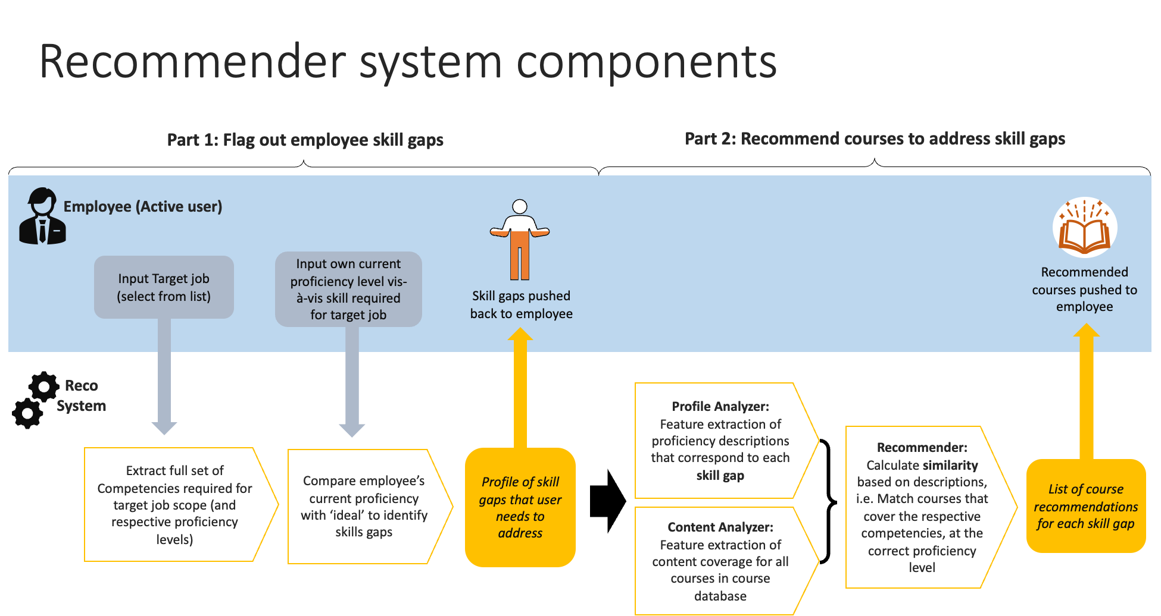
Demo

Slide 29

Next Steps
Identified areas for future data collection (e.g. employee proficiency, course details) once an internal competency framework is established.
Decide how to address employee skill gaps (Level by level, grouping proficiency levels etc). These rules can be easily weaved into the current system because of the way it is currently structured.
Cater for skills that may not have relevant courses in course database. E.g., If recommendations fall below a certain similarity score, the system can return ‘no courses found’.
Users testing on the system. With sufficient feedback data, we could better evaluate how useful the recommendations are in reality. This can be used to further fine-tune the model.
Explore further types of analysis, e.g. topic modelling
Notes:
1: After our own competency frameworks are rolled out, we can collect data in line with what is required to build the recommender system.
2: For future iterations of the system, grouping of proficiency levels for recommendations could be explored further (Decision on how to address employee skill gaps (be it Level by level or grouping proficiency levels etc) can be made in collaboration with SA). These rules can then be easily built into the current system because of the way it is currently structured.
3: next, to cater for those skills without relevant courses in the database, we could set a benchmark for what is a good similarity score. If recommendations fall below a certain similarity score, the system can return ‘no courses found’. We did not do this for POC as the database used was from coursera so many courses available.
4: For further validation of the model, it would be beneficial to get a group of users to test run the model. With sufficient data collected, we could better evaluate how useful the recommendations are. Recommendations indicated useful by the user will be evaluated as 'correct' recommendations. Using these inputs to improve the model- how? Use employee’s ratings of how relevant a course is to improve the model→ when enough data is collected, the course matches that employees deem more relevant can be weighed more heavily.
5: can consider exploring exploring other analyses such as topic modelling, which can be run as an additional step after TF-IDF.
(In this context, the aim of LDA would be to find what topic a course belongs to, based on the course description. // allows to identify topics within the documents and map documents to those topics.)
https://towardsdatascience.com/topic-modeling-and-latent-dirichlet-allocation-in-python-9bf156893c24
https://github.com/susanli2016/NLP-with-Python/blob/master/LDA_news_headlines.ipynb
https://towardsdatascience.com/light-on-math-machine-learning-intuitive-guide-to-latent-dirichlet-allocation-437c81220158

Slide 30

Internship Learning points
Project scope allowed me to apply knowledge/skills from my course
Interesting experience when dealing with challenges along the way
Real-world practice enhanced my learning experience
More in-depth knowledge on recommender systems from research
Better able to compare across various approaches to select the best one
More fluent in Jupyter/python
Picked up good practices, e.g. clear documentation
Notes:
Hands-on, allowed me to utilise what I have learnt in school, also got to practice coding and troubleshooting

Slide 31

Thank you.

